Slide 1
Smart Companion
LumoHack 2018
Travis Friday Jatin Suneja
Takudzwa Mhonde Ibrahim El-Chami

Slide 2
Background
Imec’s SWEET study (https://www.imec-int.com/en/articles/imec-s-sweet-study-collects-world-s-largest-dataset-on-stress-detection)
World’s largest dataset on stress detection in the work place
First large-scale study:
Multiple wearables to establish the link between physiological stress symptoms and self-reported stress in real-life.
Provides better understanding of correlation between periods of stress and its indicators
For example: average heart rate variability correlated with their perceived stress levels.
However, the study does not include first responders
There is no current (comprehensive) database to measure anxiety/stress levels among first responders.
Notes:
https://www.imec-int.com/en/articles/imec-s-sweet-study-collects-world-s-largest-dataset-on-stress-detection

Slide 3
Problem and Overview
Problem:
Any suggested solutions must rely on actual data collected from first responders, in order to be relevant
No current database
Overview of proposed solution:
Use a similar platform to imec’s SWEET study to anonymously collect similar type of data relevant to first responders
Build a smartphone app to help first responders keep track of their own anxiety/ stress levels
App is completely anonymous

Slide 4
Lumohacks 2018 – Summary of work
Summary of what we were trying to do: Since there is no current comprehensive study or a database for stress levels for first responders, our plan was:
since there is no current database, build a database
build hardware to anonymously collect data on users, and upload the data to a database.
make a survey platform for first responders to anonymously answer questions regarding their stress levels/ mental wellness throughout the day, and upload the data to a database.
when there is enough data:
statistical analysis to better understand what the data entails including stress level stats, correlations, etc..
Other research/academic studies, including as machine learning or other evaluative/ predictive analysis
build a survey app for first responders to evaluate their own stress levels on a weekly basis and weekly monitor their levels (in addition to physiological data). Then compare their stress levels to their teams' average stress levels, if their stress levels are above their teams average, they receive a notification that they should destress (in the app setup, we ask users to suggest methods that they find help them destress).

Slide 5
Lumohacks 2018 – Summary of work
What we were able to finish within 24hrs.
we built a small and limited database
we built hardware that anonymously collect data and uploads the data. We didn't have all the components/modules that we needed, but we were able to get it working
we researched stress levels survey questions, and put together a survey. We received insightful feedback from mentors during the event, so, we were able to change the type of questions accordingly.
uploading data to the database seemed to have been working, however we didn't have enough data for any meaningful statistical analysis.
we were almost finishing up with building a self-assessment iOS app to monitor stress levels. Following feedback and suggestions from mentors, we changed the rating system as well as the number of questions to adhere with time limitations of first responders.
We changed the rating system from 1-5 to a slider type of rating, as well as lowered the number of questions to 3. We also included a section where users would be able to describe a recent traumatic incident they had at work using three words to describe the incident.

Slide 6
Approach (Stage 1/2) - Database
Stage One: Build a database for first responders
Anonymous data collection from first responders within departments.
In no way, contributors to the database would be identified at any point
Hardware (such as a fitbit, not necessarily fitbits): collect physiological data throughout shifts
Survey: self-reported stress from participants
Cellphone app
Computer online survery

Slide 7
Approach (Stage 1/2) - Database
Collect data over the course of 3-4 months
Using collected data
Find statistical data about first responders throughout the Lower Mainland
Statistical analysis:
averages of stress levels of first responders
Averages of stress levels within individual teams (such as VPD, RCMP, EMT, ICU staff, etc.. )
Other Uses of the database (academic and other research uses):
training sets for machine learning and prediction algorithm
research/studies, including lowering stress levels among first responders
Early detecting of deviation patterns in stress levels
Correlation between physiological activities and stress levels

Slide 8
Approach (Stage 2/2) – Hardware + Phone App
Stage Two: Personal self-monitoring stress levels smartphone application (smart companion)
Individual users would test out their own stress levels throughout the day, anonymously
Hardware: collect physiological data throughout shifts
Survey: short, quick answer questions to self-reported stress levels from participants
At the end of the week, get a report on stress levels, as well as compare weekly results to previous weeks
* hardware and cellphone app used in stage 1 to create a database are also used in stage 2 for daily/weekly self-monitoring stress levels

Slide 9
Hardware – links to app and database
Collect physiological data using multiple sensors: heart rate, steps count, balance, etc.
Push button to count the number of stressful events/situations per day
Connect the board to an app to visualize and post data onto database
Hardware wouldn’t look this scary (we had to improvise for this event). More like a fitbit

Slide 10
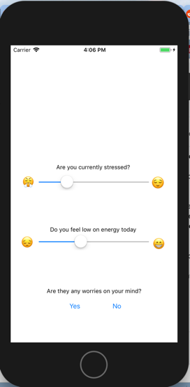
Survey (Smart Companion app)
App designed for preventative measures against high stress levels and its impacts
3 Short, quick answer questions for participants to self-report stress levels during their shifts
Designed to take as minimum time as possible (10s-20s)

Slide 11
Survey (Smart Companion app)
Friendly reminders to complete survey during the day as well as
Users set their own suggestions for stress relievers

Slide 12
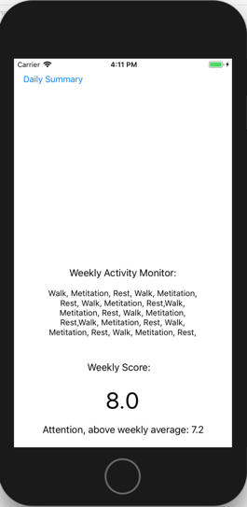
Survey (Smart Companion app)
Weekly results (compared with previous weeks) based on physiological and self-reported survey
Suggestions for user-input stress relievers

Slide 13
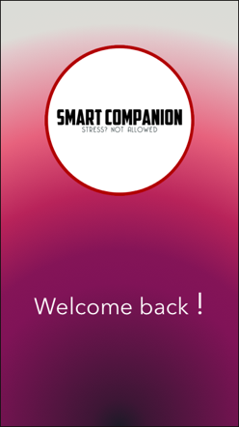
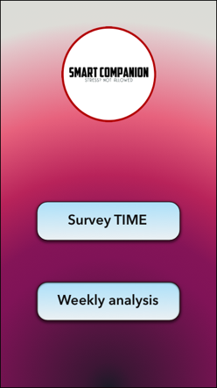
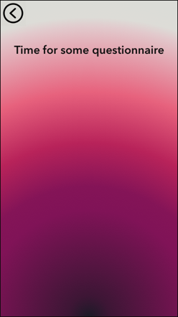

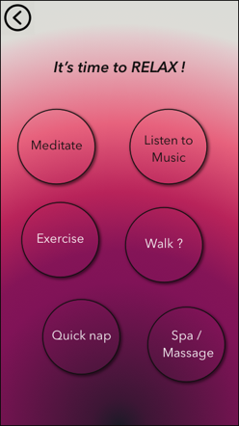
App layout
Worked on app design, but didn’t have enough time to implement everything

Slide 14
Plan to move forward
If case any of the organizations are interested in such a study
We can reach out to the researchers/colleagues at imec who conducted the SWEET study. A team member has access to some resources at imec, because he is still doing research/internship there. We can also ask if researchers at imec/KUL would want to be a part of a study aimed towards first responders. We can also reach out to profs/researchers at UBC and SFU with similar research focus.
We can also check if we'd be able to use the same hardware they used in the SWEET stress study or if we can use similar hardware where we custom modify it to collect data more relevant to first responders, as well as modify the survey/application based on feedback we received (as well as continued feedback from mentors) to make it more user-friendly for first responders.

